Slide 1

HealthyEats App Design
Komal Nirania

Slide 2
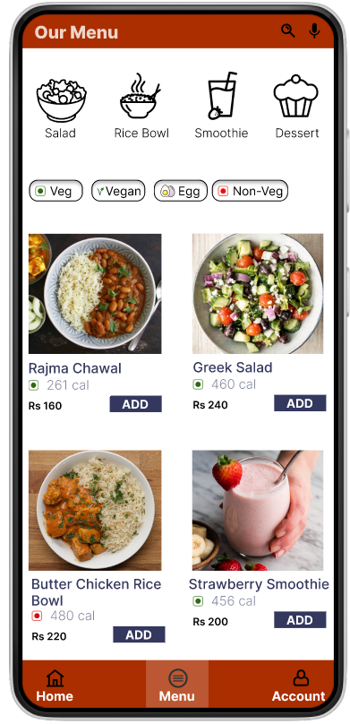
Project overview
The product:
HealthyEats is a large fast food chain located in the suburbs of a metropolitan area. HealthyEats strives to deliver healthy, budget friendly and vegan options. HealthyEats targets customers like commuters and workers who lack the time or ability to prepare meals at home.
Preview of selected polished designs.
Project duration:
June 2023 to August 2023

Slide 3
Project overview
The problem:
Busy workers and commuters lack the time necessary to prepare a meal.
The goal:
Design an app for HealthyEats that allows users to easily order fresh, healthy and budget friendly dishes.

Slide 4
Project overview
My role:
UX designer designing an app for HealthyEats from conception to delivery.
Responsibilities:
Conducting interviews, paper and digital wireframing, low and high-fidelity prototyping, conducting usability studies, accounting for accessibility, and iterating on designs.

Slide 5
User research
Personas
Problem statements
User journey maps
Understanding
the user

Slide 6
User research: summary
I conducted interviews and created empathy maps to understand the users I’m designing for and their needs. A primary user group identified through research was working adults and college students who don’t have time to cook meals.
This user group confirmed initial assumptions about HealthyEats customers, but research also revealed that time was not the only factor limiting users from cooking at home. Other user problems included obligations, interests, or challenges that make it difficult to get groceries for cooking or go to restaurants in-person.

Slide 7
User research: pain points
1
2
3
4
Time
Accessibility
IA
Money
Working adults are too busy to spend time on meal preparation.
Platforms for ordering food are not equipped with assistive technologies
Text-heavy menus in apps are often difficult to read and order from
College students have limited access to budget friendly and healthy meals.

Slide 8
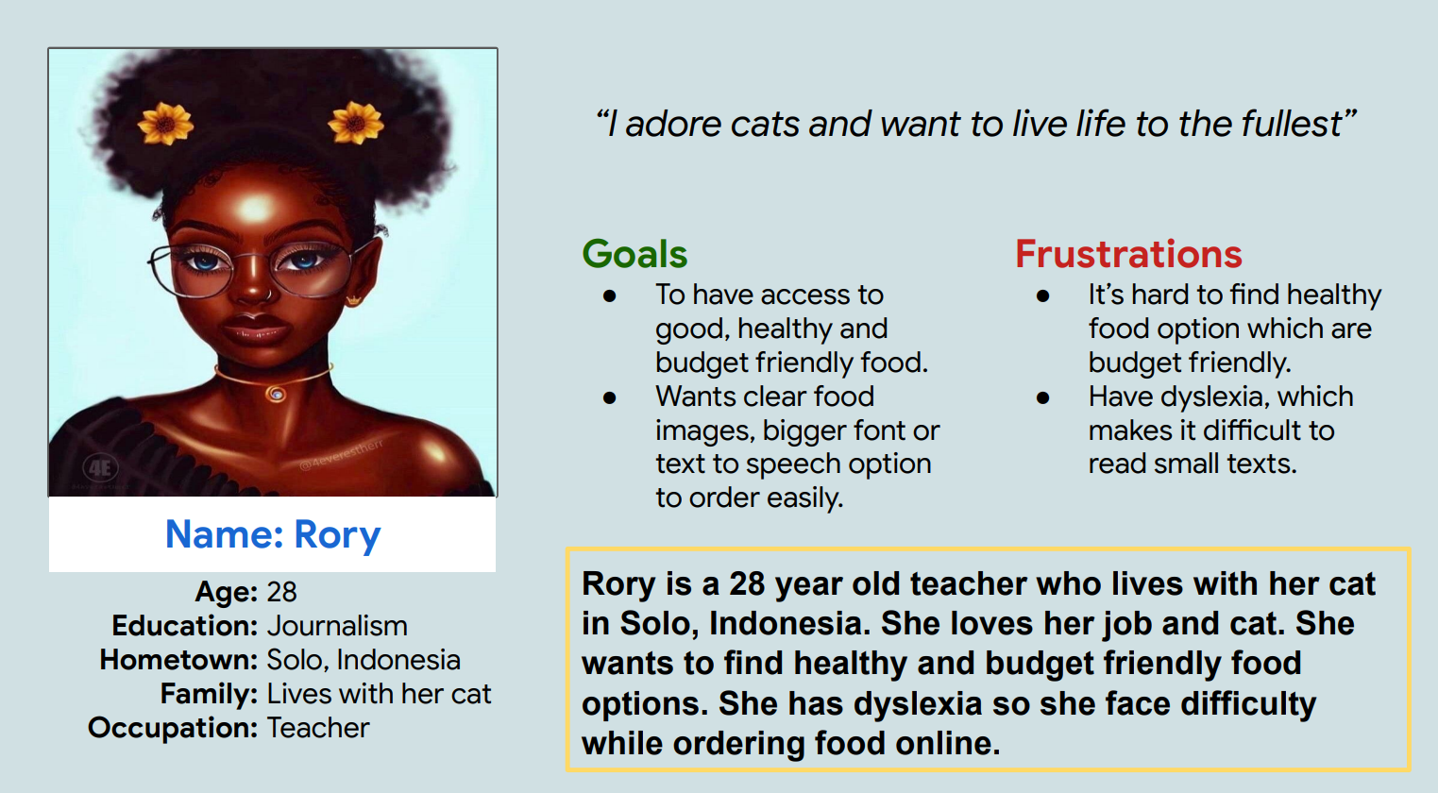
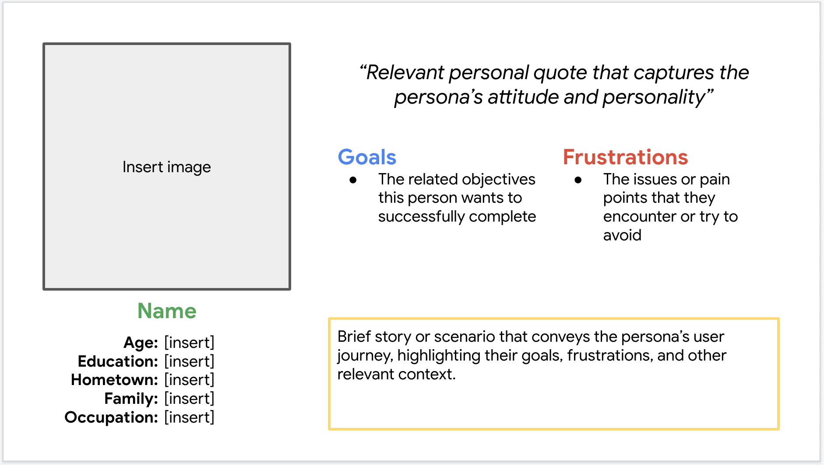
Persona: Rory
Problem statement:
Rory is a teacher, conscious about her health and have dyslexia who needs healthy food options and screen reader technology or bigger font size because of limited healthy food options and her difficulty to read small texts.

Slide 9
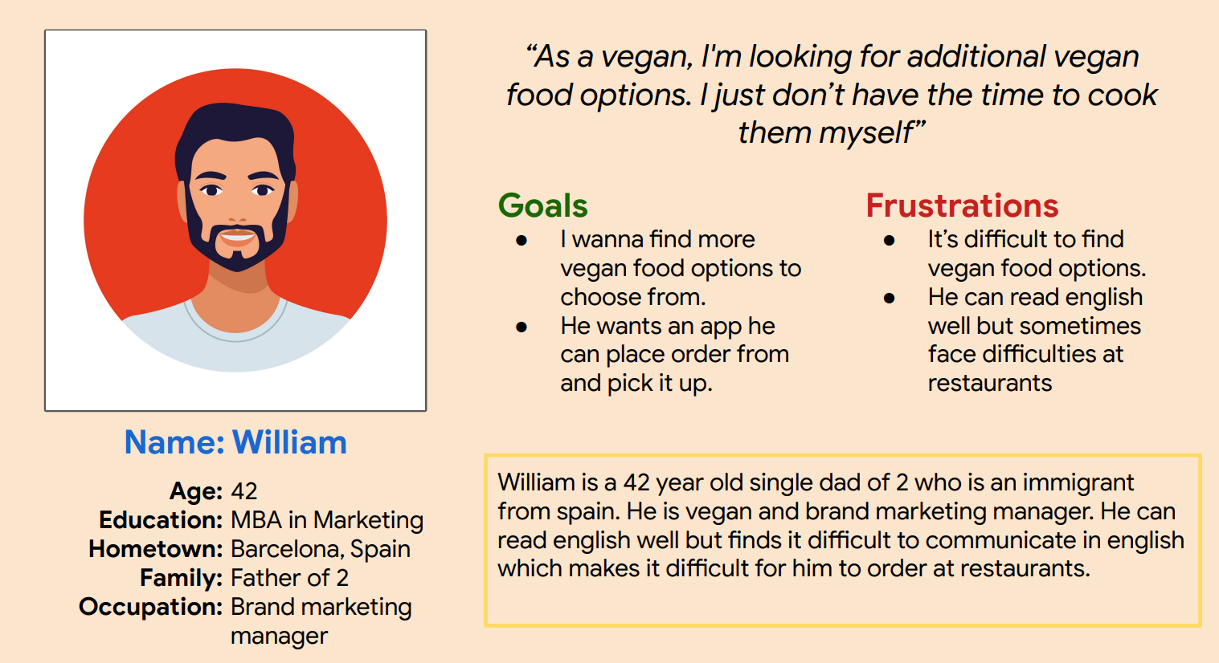
Persona: William
Problem statement:
William is a busy father, immigrant, and vegan who needs vegan food option that he can order through app because he can read english well but sometimes face difficulties at restaurants

Slide 10
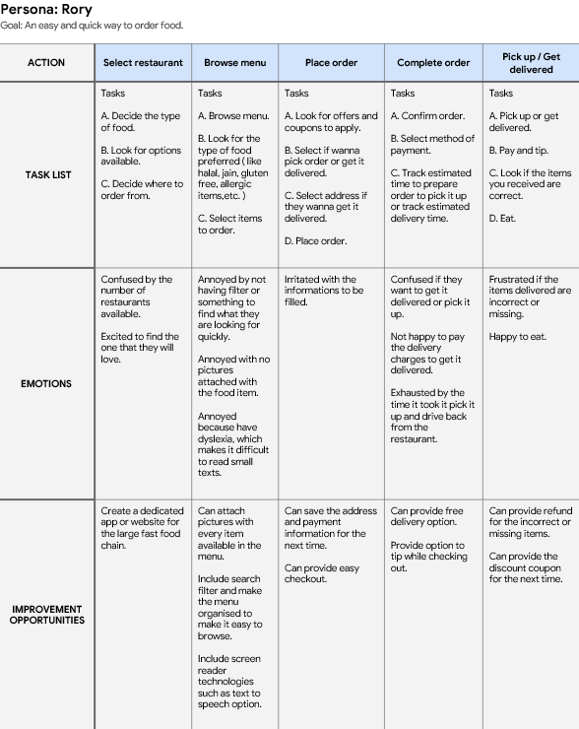
User journey map
Rory’s user journey revealed how helpful it would be for users to have access to a dedicated HealthyEats.
Image of user journey map

Slide 11
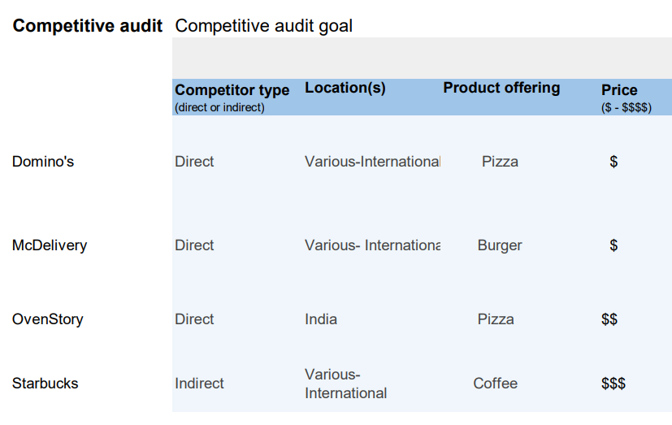
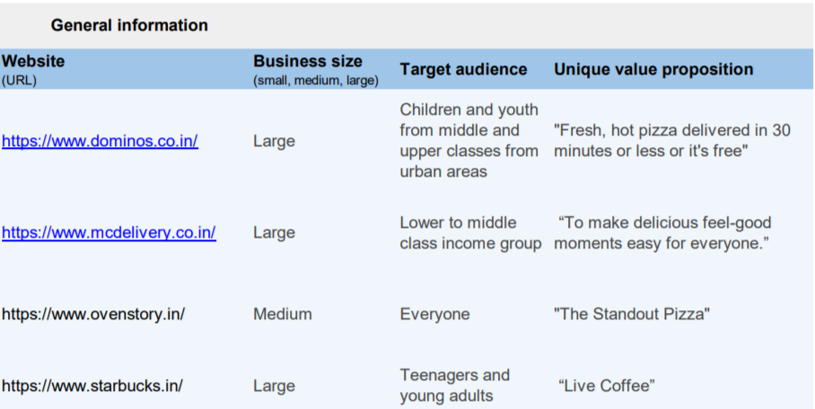
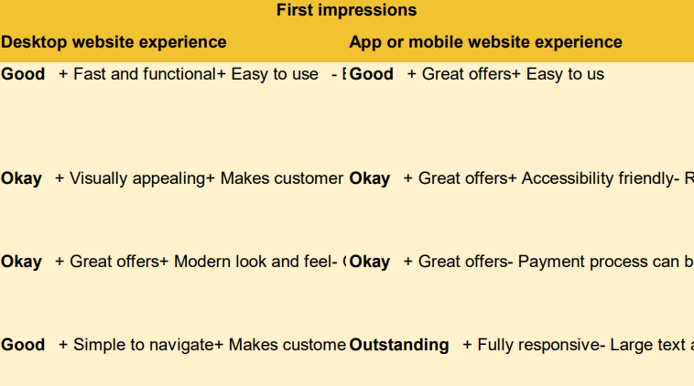
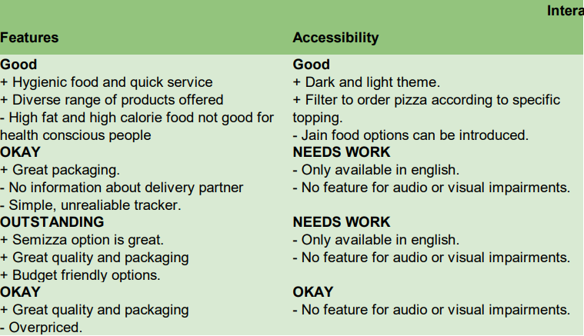
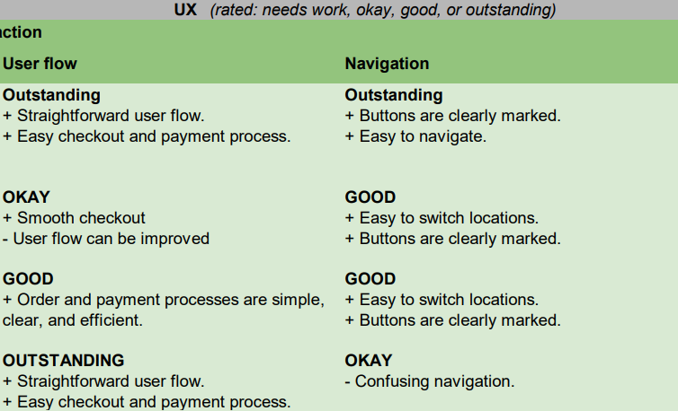
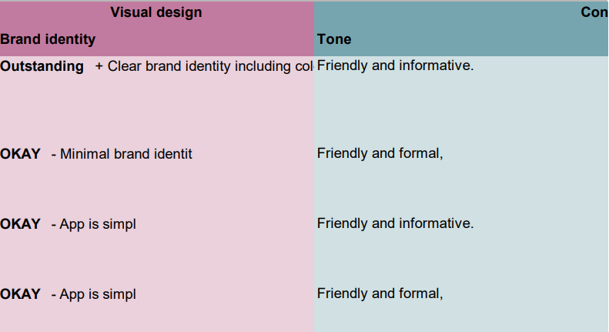
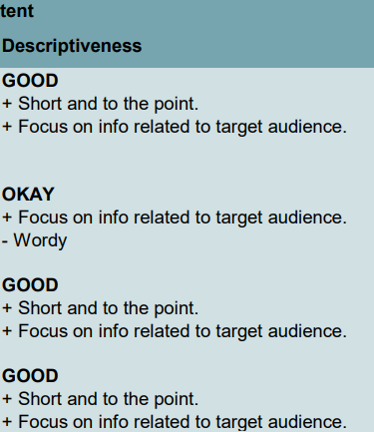
Competitive Audit

Slide 12
Paper wireframes
Digital wireframes
Low-fidelity prototype
Usability studies
Starting
the design

Slide 13
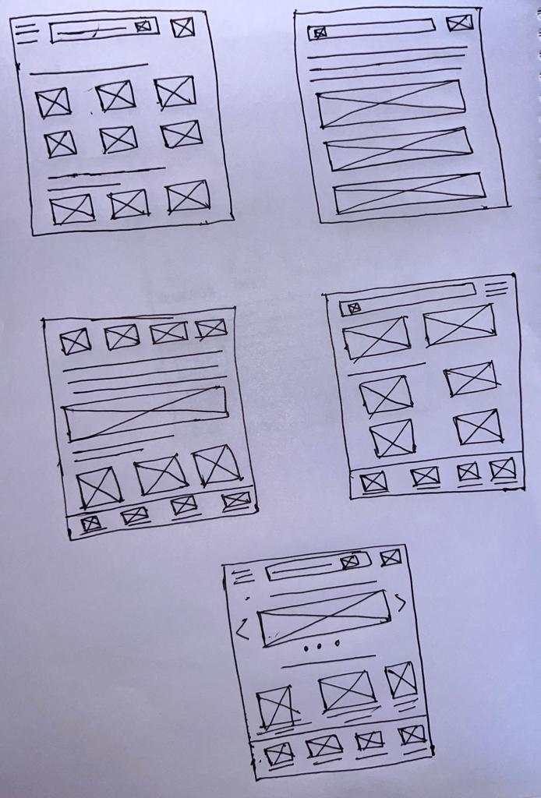
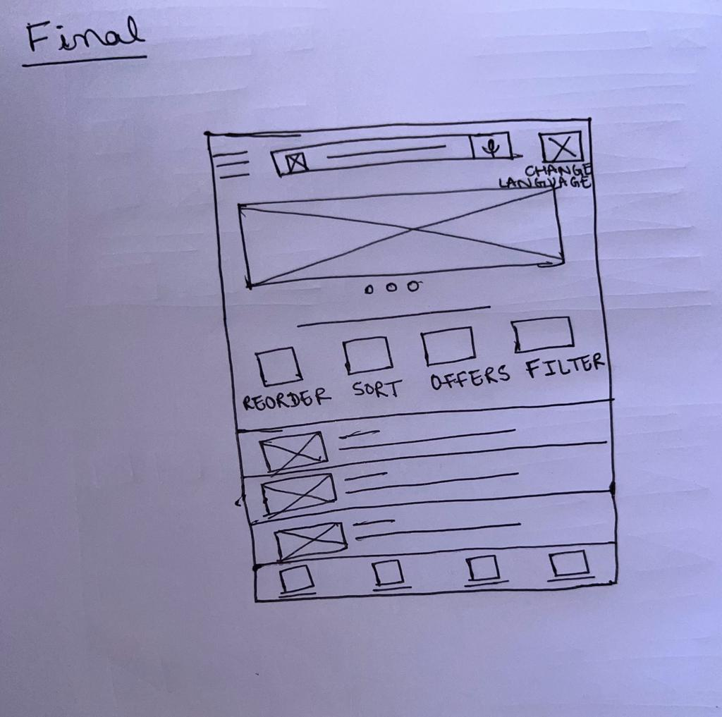
Paper wireframes
Taking the time to draft iterations of each screen of the app on paper ensured that the elements that made it to digital wireframes would be well-suited to address user pain points. For the home screen, I prioritized a quick and easy ordering process to help users save time.
Image of paper wireframes including five different versions of the same screen and one image of the new, refined version

Slide 14
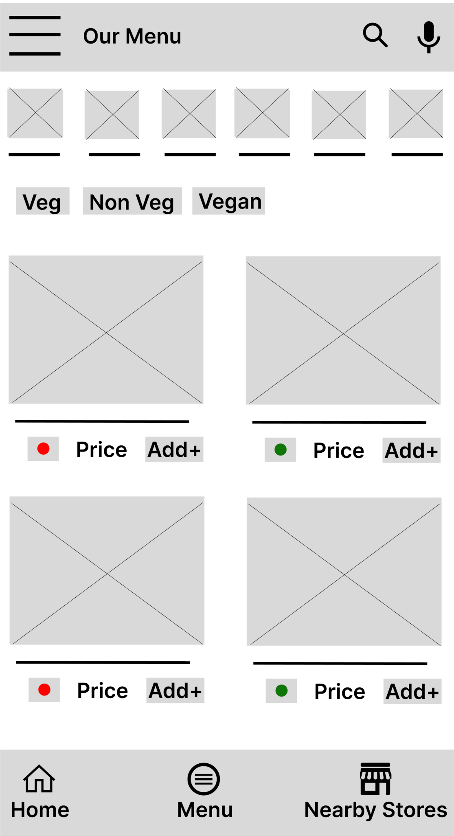
Digital wireframes
As the initial design phase continued, I made sure to base screen designs on feedback and findings from the user research.
These buttons at the top of the menu makes it fast and easy for users to order by filtering according to their preference.
This button makes it fast and easy for users to add the item to cart.

Slide 15
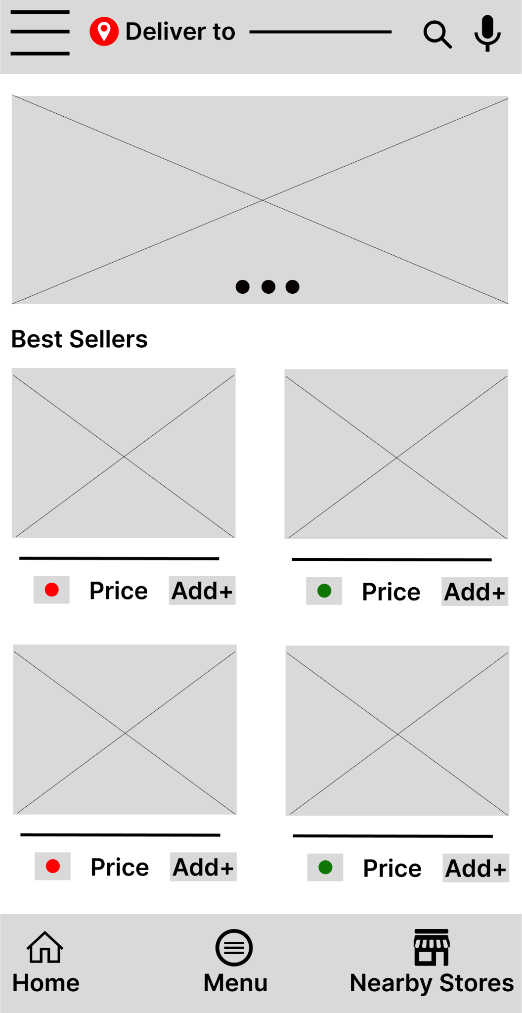
Digital wireframes
People with dyslexia can search easily using voice search.
Easy navigation was a key user need to address in the designs in addition to equipping the app to work with assistive technologies.
Insert second wireframe example that demonstrates design thinking aligned with user research

Slide 16
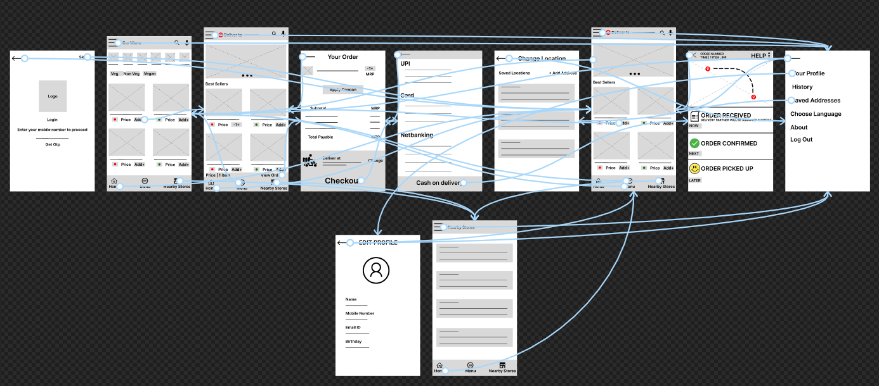
Low-fidelity prototype
Using the completed set of digital wireframes, I created a low-fidelity prototype. The primary user flow I connected was building and ordering a pizza, so the prototype could be used in a usability study.
View the HealthyEats https://www.figma.com/proto/qiwCisarEStOYcwmnfcoE8/prototype?type=design&node-id=12-415&t=clwYxJMiETRl4n6h-1&scaling=scale-down&page-id=0%3A1&starting-point-node-id=12%3A415&mode=design
Screenshot of prototype with connections or prototype GIF

Slide 17
Usability study: findings
Write a short introduction to the usability studies you conducted and your findings.
Round 1 findings
Round 2 findings
1
Users want to order healthy meal quickly
1
Should have an egg filter too
2
Users want a delivery option
2
Sign up/ Login process needs some work
3
Users want budget friendly options

Slide 18
Refining
the design
Mockups
Testing and iterating designs
High-fidelity prototype
Accessibility

Slide 19
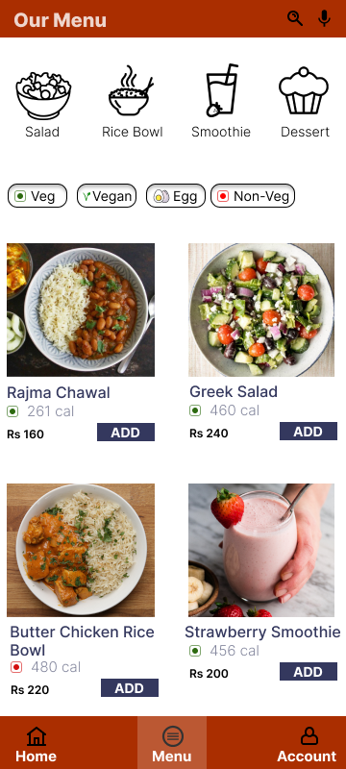
Mockups
Before usability study
After usability study
Early designs allowed for some customization, but after the usability studies, I added additional option to filter food with only egg. I also revised the design by removing side menu so users have smooth user flow when they first land on the screen.
Image of selected screen after usability study

Slide 20
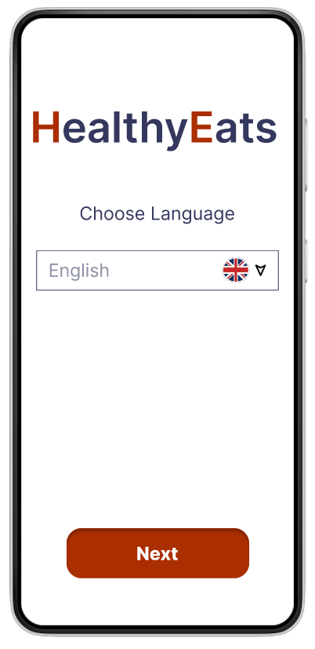
Mockups
The second usability study revealed frustration with no option for language change. To streamline this flow, I added a new page so users can select language according to their preference .

Slide 21
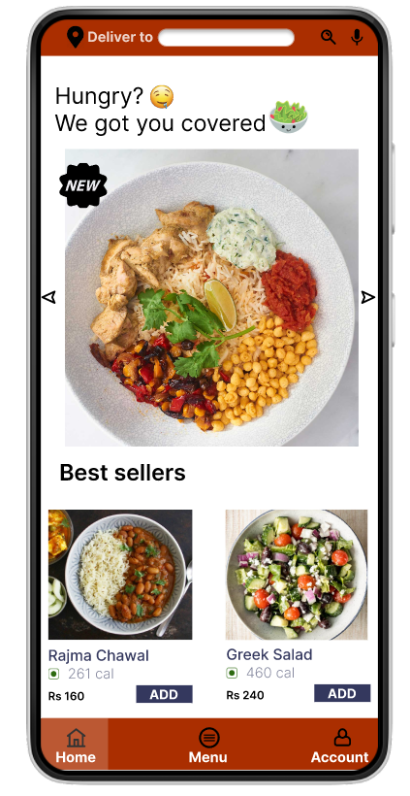
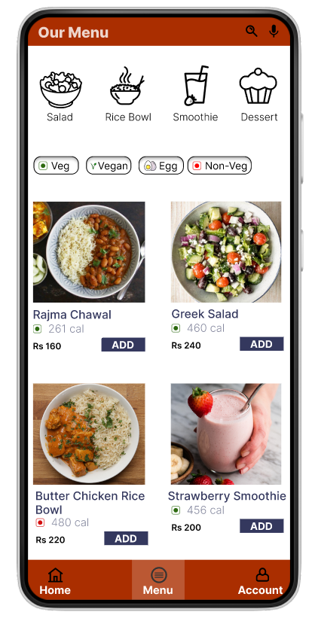
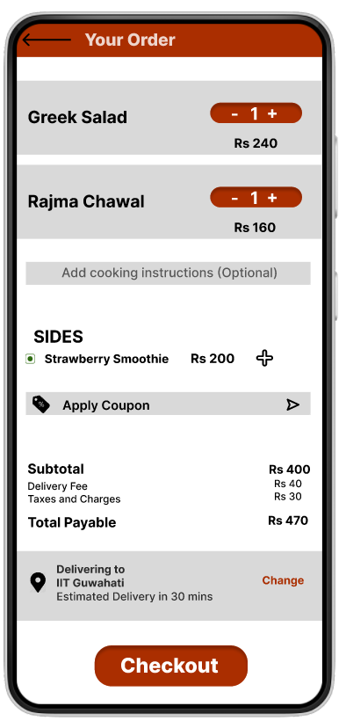
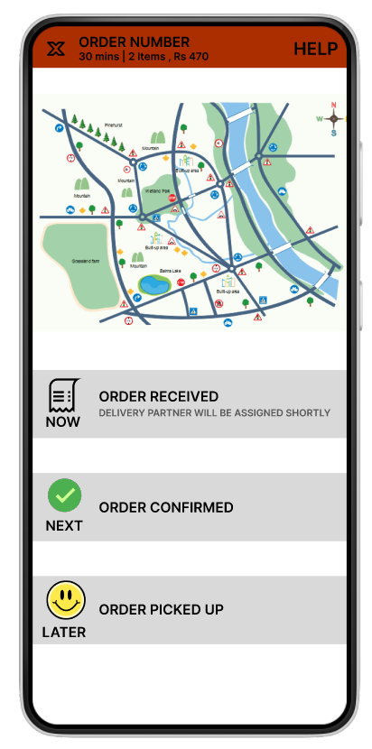
Mockups
Main mockup screen for display
Main mockup screen for display
Main mockup screen for display
Main mockup screen for display

Slide 22
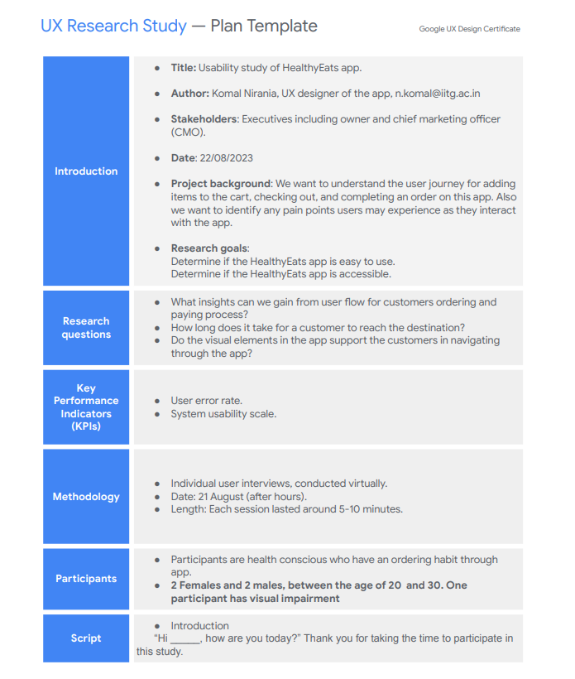
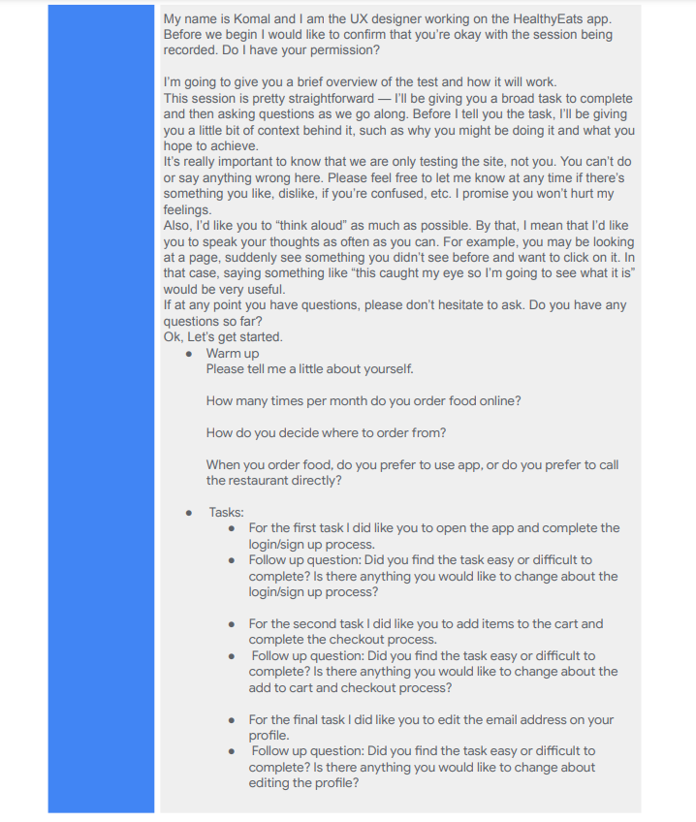
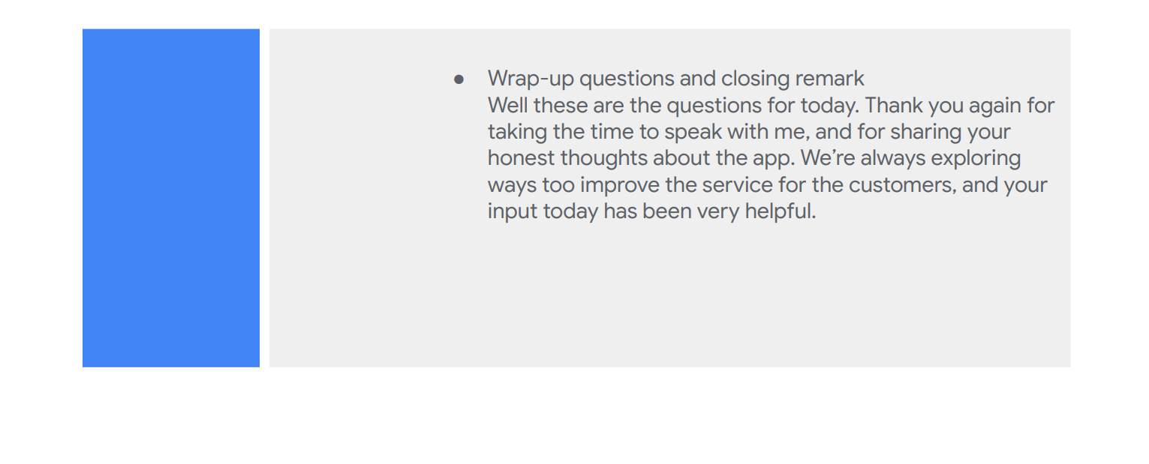
UX Research Study Plan

Slide 23
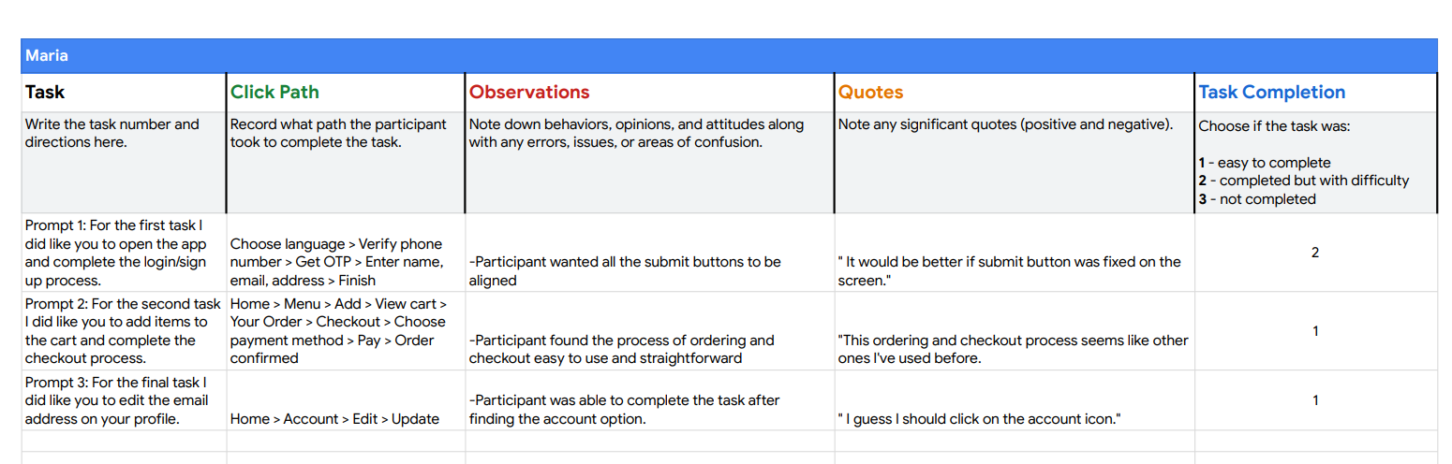
Usability Study

Slide 24
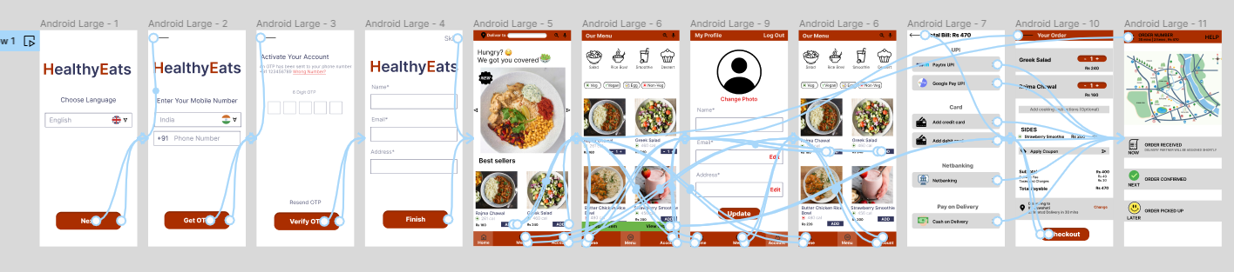
High-fidelity prototype
The final high-fidelity prototype presented cleaner user flows. It also met user needs for delivery option.
View the HealthyEats
https://www.figma.com/proto/qiwCisarEStOYcwmnfcoE8/prototype?type=design&node-id=53-329&t=pHH6B3tIeJbTMnX3-1&scaling=scale-down&page-id=48%3A328&starting-point-node-id=53%3A329&mode=design
Screenshot of prototype with connections or prototype GIF

Slide 25
Accessibility considerations
1
2
3
Provided access to users who are vision impaired through adding images and by adding WCAG approved colors to the design.
Used icons to help make navigation easier.
Used microphone for the people with dyslexia so that they can search through voice control.

Slide 26
Going forward
Takeaways
Next steps

Slide 27
Takeaways
Impact:
The app makes users feel like HealthyEats really thinks about how to meet their needs.
One quote from peer feedback:
“The app made it so easy to order food I would definitely use this app as a go-to for a delicious, fast, and even healthy meal.”
What I learned:
While designing the HealthyEats, I learned that the first ideas for the app are only the beginning of the process. Usability studies and peer feedback influenced each iteration of the app’s designs.

Slide 28
Next steps
1
2
Conduct another round of usability studies to validate whether the pain points users experienced have been effectively addressed.
Conduct more user research to determine any new areas of need.

Slide 29
Insert a few sentences summarizing the next steps you would take with this project and why. Feel free to organize next steps in a bullet point list.
Let’s connect!
Thank you for your time reviewing my work on the HealthyEats app! If you’d like to see more or get in touch, my contact information is provided below.
Email: n.komal@iitg.ac.in
LinkedIn: https://www.linkedin.com/in/komalnirania

